Slide 1

American association of independent periodontists
January 13, 2016
Principles of Marketing
www.AAIPsheldon.com

Slide 2
The Marketing Funnel
-- Townsend 1924

Slide 3
The Marketing Funnel
All Sources of Patients

Slide 4
The Marketing Funnel
All Sources of Patients
Find out about you

Slide 5
The Marketing Funnel
Call your office

Slide 6
The Marketing Funnel
Schedule Appointment

Slide 7
The Marketing Funnel
Show Up

Slide 8
The Marketing Funnel
Need Treatment

Slide 9
The Marketing Funnel
Want Treatment

Slide 10
The Marketing Funnel
Schedule Treatment

Slide 11
Increasing the Width of the Marketing funnel
Find out about you
Call your office
Schedule Appointment
Show Up
Need Treatment
Want Treatment
Schedule Treatment

Slide 12
Your Funnel

Slide 13
“Public”
Doctor B
Doctor A
Doctor C
Your Funnel

Slide 14
Why don’t patients go through Dr. A, B, or C’s funnel?
Doctor B
Doctor A
Doctor C
Your Funnel

Slide 15
Doctor B
Doctor A
Doctor C
They don’t do the procedure.
They haven’t diagnosed the problem.
The patient doesn’t like the doctor or staff.
They haven’t solved the problem.
Your Funnel

Slide 16
Doctor B
Doctor A
Doctor C
This creates an entirely new funnel.
Your Funnel

Slide 17
Doctor B
Doctor A
Doctor C
Dissatisfied Patients
Your Funnel

Slide 18
Doctor B
Doctor C
Dissatisfied Patients
Doctor A
Your Funnel

Slide 19
Looking for Expertise
Emergencies
Special Procedures
No Care for a long Time
Cosmetic
Dissatisfied Patients
New arrivals
Second opinions
Your Funnel

Slide 20
positioning

Slide 21
positioning
Find out what position you own.

Slide 22
positioning
Find out what position you own.
Adopt a position that you want to own.

Slide 23
positioning
Find out what position you own.
Adopt a position that you want to own.
Convince everyone to concentrate exclusively on this one positioning approach.

Slide 24
Find out what position you own.
Adopt a position that you want to own.
Convince everyone to concentrate exclusively on this one positioning approach.
From time to time, evaluate your PR position along with your advertising, merchandising, and overall marketing positions.
--Hubbard, PR Series

Slide 25
An ad must be factual and explicit
What is it?
How valuable is it?
What does it do?
How easy is it to do it?
How costly is it?
How do you acquire it?
Where do you get it from?
-- Hubbard

Slide 26
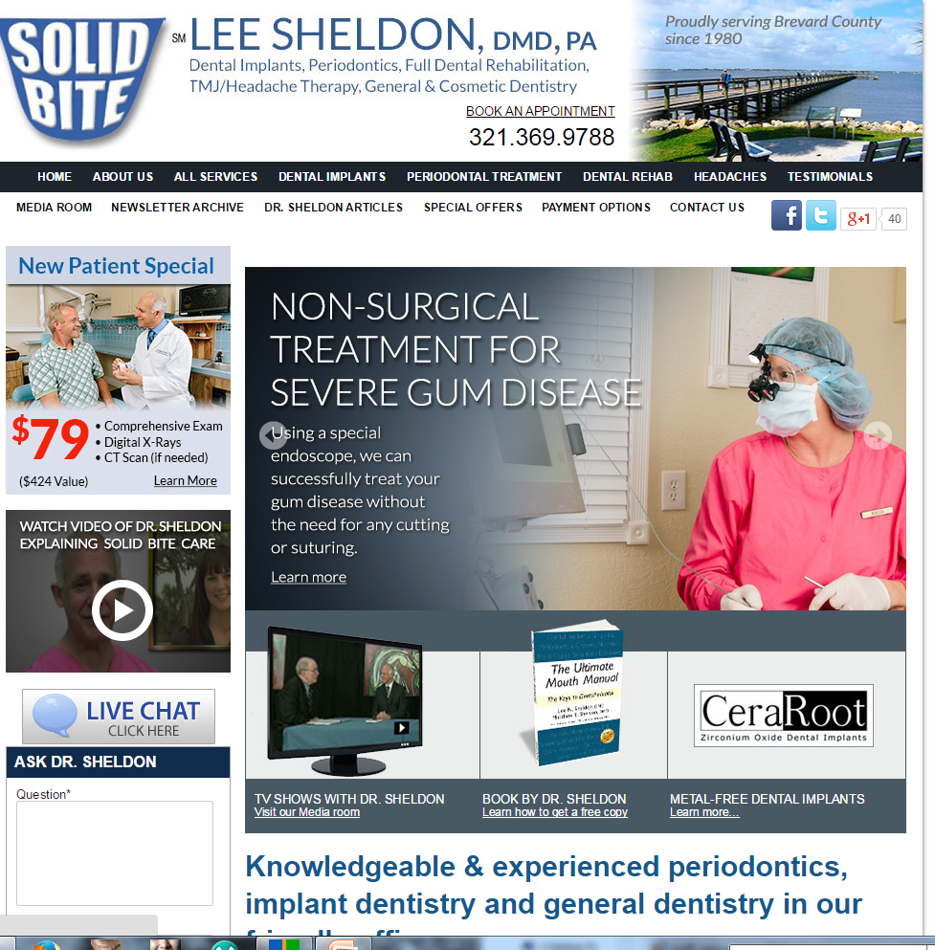
What is it?
How valuable is it?
What does it do?
How easy is it to do it?
How costly is it?
How do you acquire it?
Where do you get it from?

Slide 27
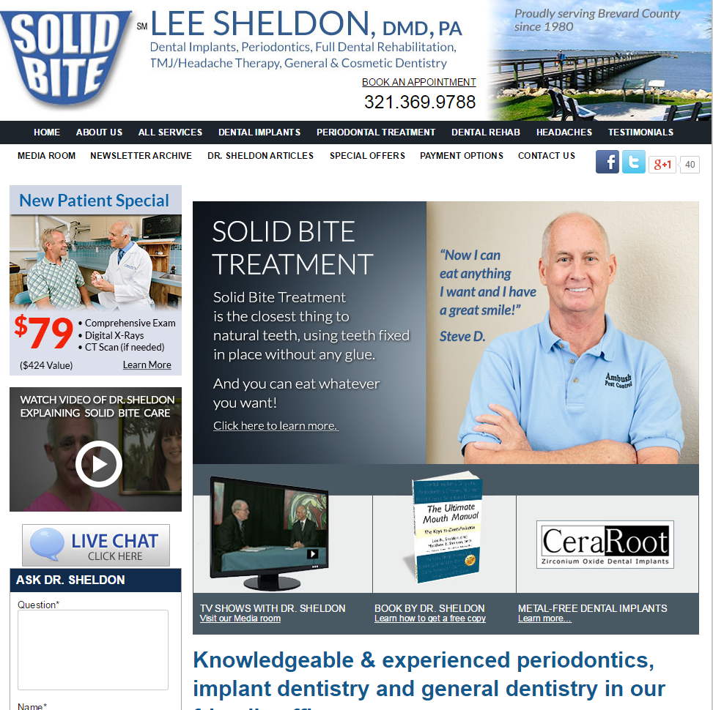
What is it?
How valuable is it?
What does it do?
How easy is it to do it?
How costly is it?
How do you acquire it?
Where do you get it from?

Slide 28
What is it?
How valuable is it?
What does it do?
How easy is it to do it?
How costly is it?
How do you acquire it?
Where do you get it from?

Slide 29
What is it?
How valuable is it?
What does it do?
How easy is it to do it?
How costly is it?
How do you acquire it?
Where do you get it from?

Slide 30
What is it?
How valuable is it?
What does it do?
How easy is it to do it?
How costly is it?
How do you acquire it?
Where do you get it from?

Slide 31
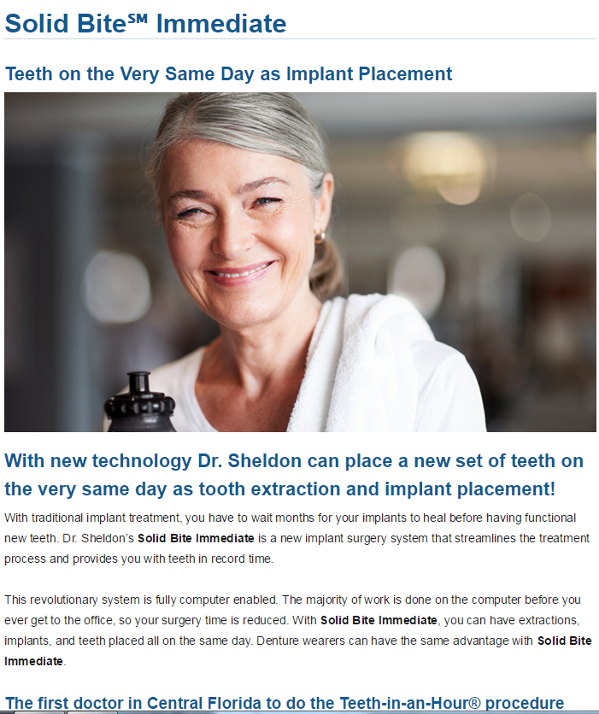
What is it?
How valuable is it?
What does it do?
How easy is it to do it?
How costly is it?
How do you acquire it?
Where do you get it from?

Slide 32
What is it?
How valuable is it?
What does it do?
How easy is it to do it?
How costly is it?
How do you acquire it?
Where do you get it from?

Slide 33
What is it?
How valuable is it?
What does it do?
How easy is it to do it?
How costly is it?
How do you acquire it?
Where do you get it from?

Slide 34
What is it?
How valuable is it?
What does it do?
How easy is it to do it?
How costly is it?
How do you acquire it?
Where do you get it from?

Slide 35
What is it?
How valuable is it?
What does it do?
How easy is it to do it?
How costly is it?
How do you acquire it?
Where do you get it from?

Slide 36
Two Types of Marketing
Branding
Direct Response Marketing

Slide 37
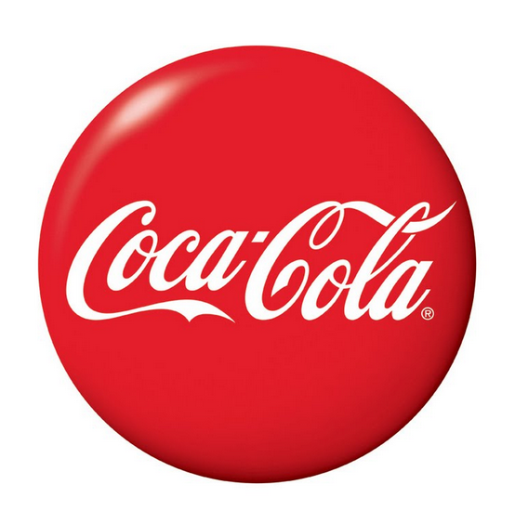
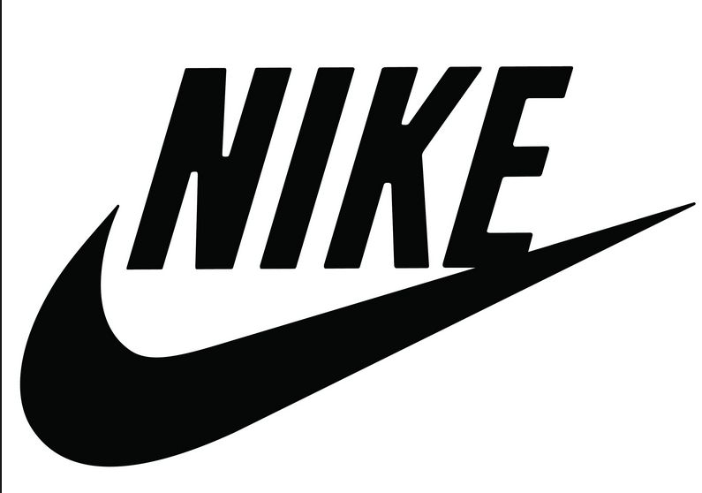
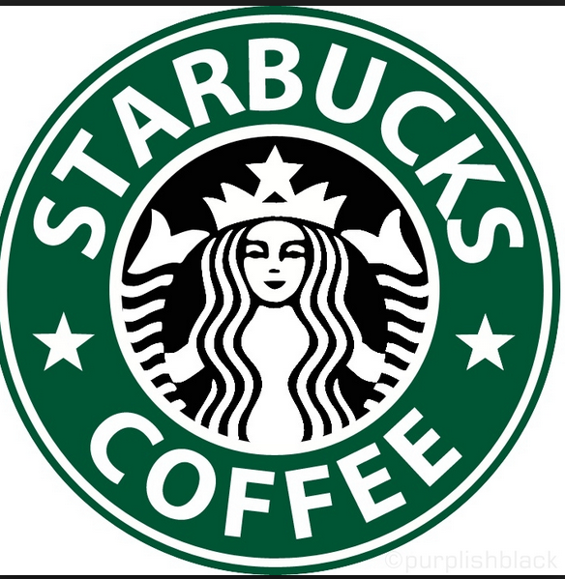
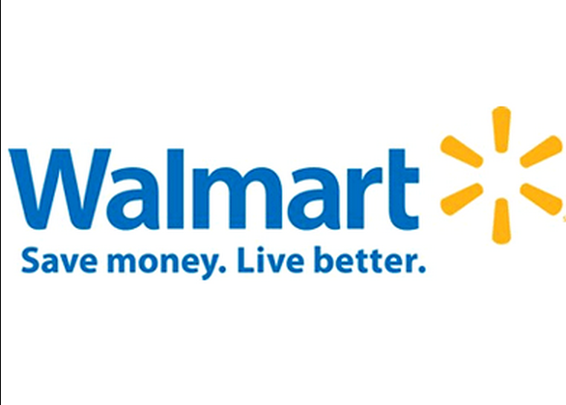
Two Types of Marketing
Branding
Mass marketing strategy
Goal—To remind customers of your brand and the products associated with your brand.
The more times the ad is run, the more likely the customer is to seek your product.
Not practical as a sole dental marketing strategy

Slide 38
Two Types of Marketing
2. Direct Response Marketing
Designed to evoke an immediate response and compel prospects to take some specific action, such as opting in to your email list, picking up the phone and calling for more information, placing an order or being directed to a web page.
—Alan Dib

Slide 39
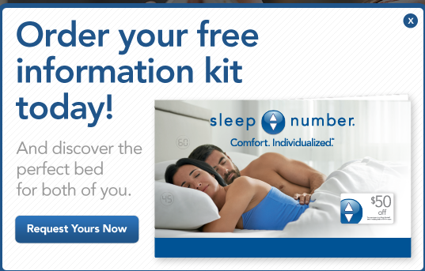

Slide 40
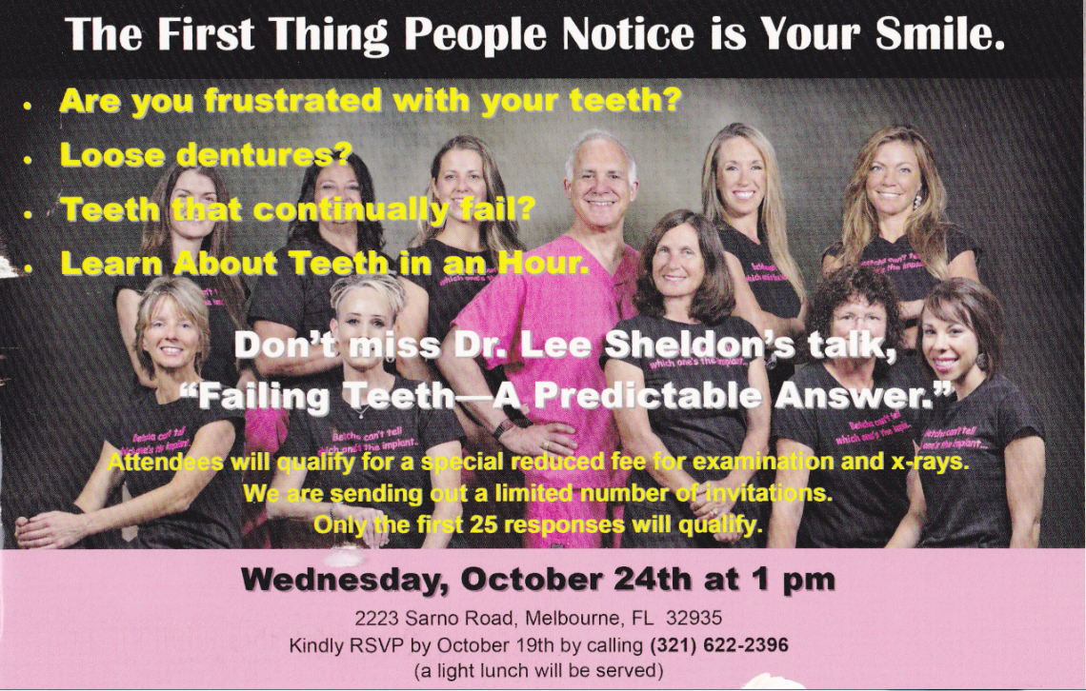

Slide 41
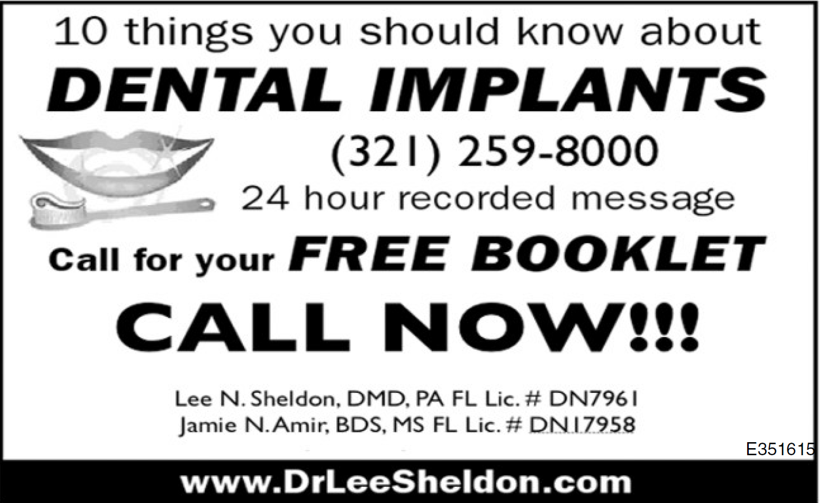

Slide 42
Killer Headline
Identify a problem.
Provide a solution
Proof
Call to Action
Dual readership path

Slide 43
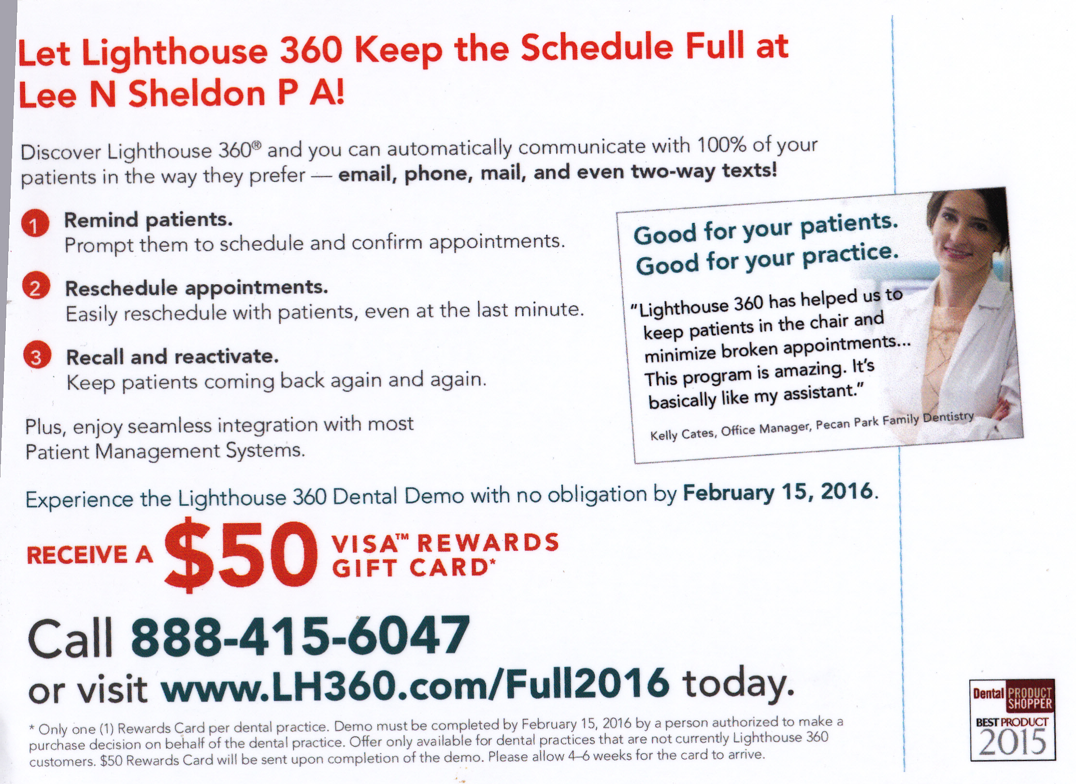
Killer Headline
Identify a problem.
Provide a solution
Proof
Call to Action
Dual readership path

Slide 44
Killer Headline
Identify a problem.
Provide a solution
Proof
Call to Action
Dual readership path

Slide 45
Killer Headline
Identify a problem.
Provide a solution
Proof
Call to Action
Dual readership path

Slide 46
Killer Headline
Identify a problem.
Provide a solution
Proof
Call to Action
Dual readership path

Slide 47
Killer Headline
Identify a problem.
Provide a solution
Proof
Call to Action
Dual readership path

Slide 48
Killer Headline
Identify a problem.
Provide a solution
Proof
Call to Action
Dual readership path

Slide 49

?
Killer Headline
Identify a problem.
Provide a solution
Proof
Call to Action
Dual readership path

Slide 50
?
Killer Headline
Identify a problem.
Provide a solution
Proof
Call to Action
Dual readership path

Slide 51
?
Killer Headline
Identify a problem.
Provide a solution
Proof
Call to Action
Dual readership path

Slide 52
?
Killer Headline
Identify a problem.
Provide a solution
Proof
Call to Action
Dual readership path

Slide 53
Killer Headline
Identify a problem.
Provide a solution
Proof
Call to Action
Dual readership path

Slide 54
Killer Headline
Identify a problem.
Provide a solution
Proof
Call to Action
Dual readership path
?

Slide 55
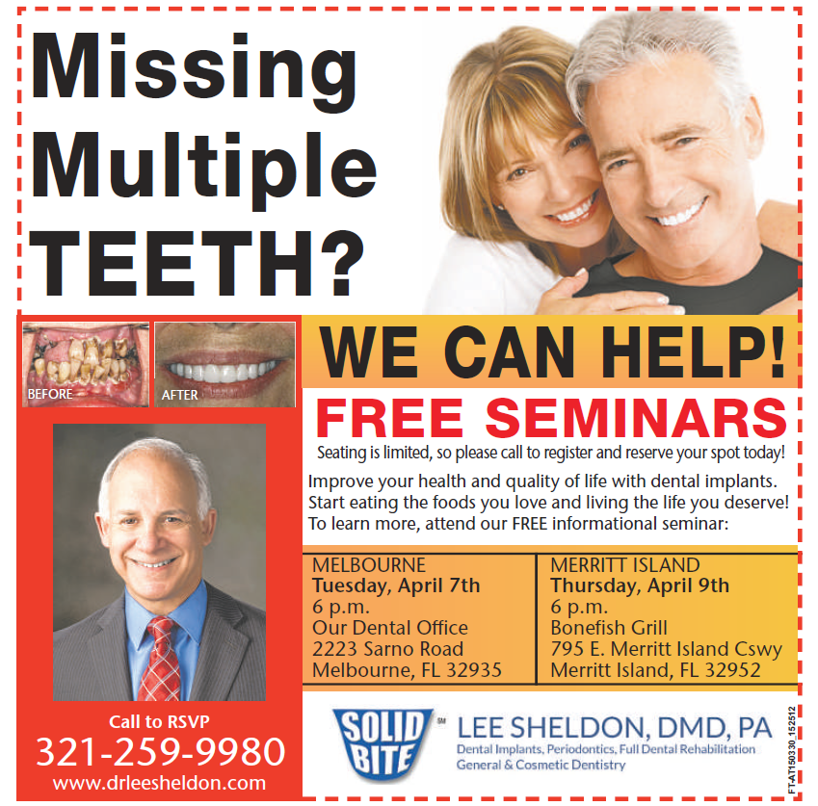
Killer Headline
Identify a problem.
Provide a solution
Proof
Call to Action
Dual readership path

Slide 56
Killer Headline
Identify a problem.
Provide a solution
Proof
Call to Action
Dual readership path

Slide 57
Killer Headline
Identify a problem.
Provide a solution
Proof
Call to Action
Dual readership path

Slide 58
Killer Headline
Identify a problem.
Provide a solution
Proof
Call to Action
Dual readership path

Slide 59
Killer Headline
Identify a problem.
Provide a solution
Proof
Call to Action
Dual readership path

Slide 60
Killer Headline
Identify a problem.
Provide a solution
Proof
Call to Action
Dual readership path

Slide 61
Combine your brand with any ad that you produce.

Slide 62
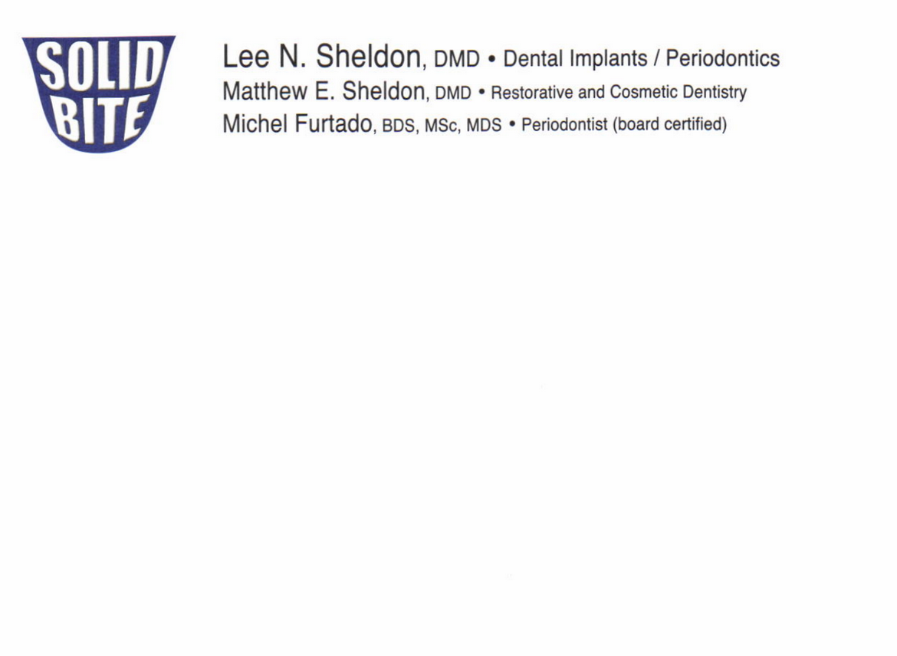

Slide 63
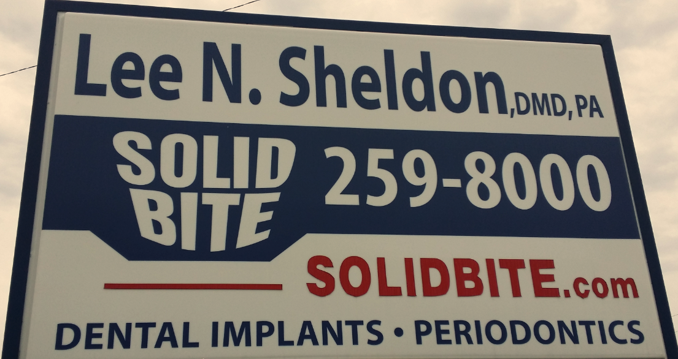

Slide 64

Testing the Ad

